Slide 1
Beyond Civics 101: Students’ Civic Learning in a 21st Century World
Philip Sisson
Provost and Vice President for Academic and Student Affairs

Slide 2
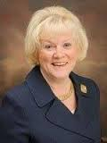
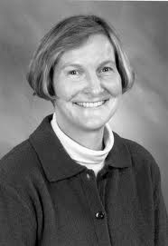
Where MCC has been…
Civic Learning Leadership
Presidential Engagement
Faculty Champions
Infrastructure and Partnerships
Grants grew staff/support
The Lowell Collaborative (LTC)
Partnership recruitment and retention
Technology tools

Slide 3
Where we are now…
Data:
1100 Students
24,000 service hours
64 sections
All academic divisions
Structure:
Regular faculty training
Noted on student transcripts
Multiple models
https://www.middlesex.mass.edu/strategicplanning/downloads/fy14fb.pdf

Slide 4
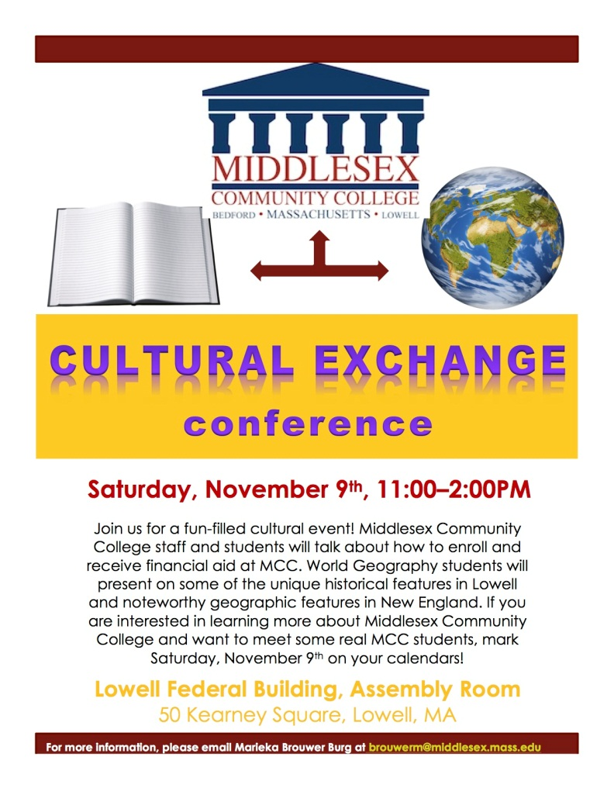
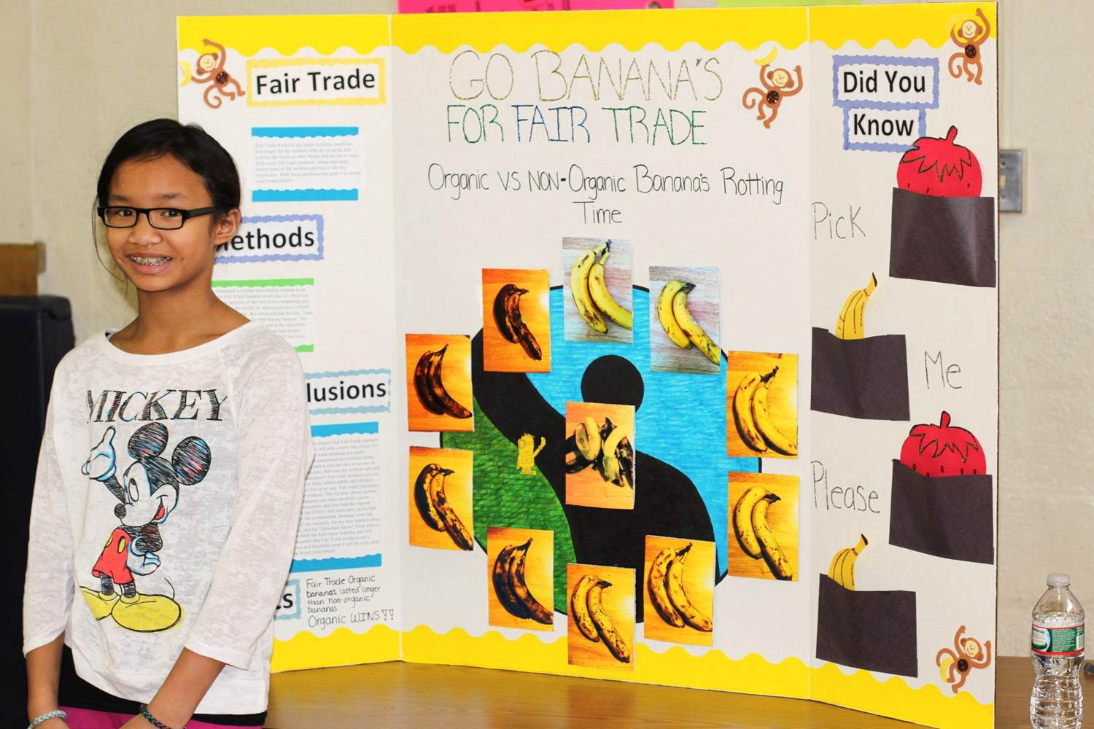
What we are building…
Global/Local Connections
Curriculum Design and Assessment Process
ISLO’s
Social Responsibility
Multicultural/Global
Personal/Professional
IDS classes
Alignment across institutions (K-16)

Slide 5
Valuable partnerships…

Slide 6
Phil Sisson Provost and Vice President of Academic and Student Affairs (781) 280-3571 sissonp@middlesex.mass.edu Carina Self Assistant Dean of Social Sciences and Service Learning (978) 322-8408 selfc@middlesex.mass.edu Cynthia Lynch Director of Service Learning (781) 280-3556 lynchc@middlesex.mass.edu

